Slide 1
Course Title - Web System Engineering
Topic Title - Introduction to PHP
Presenter’s Name - M ArunKumar
Presenter’s ID - IARE11151
Department Name - CSE ( Artificial Intelligence, and Machine Learning )
Lecture Number - #
Presentation Date - ##/04/2025

Slide 2
Introduction to PHP
https://windows.php.net/download/
XAMPP is an easy to install Apache distribution containing MariaDB, PHP, and Perl. Just download and start the installer. It's that easy. Installers created using InstallBuilder.
https://www.apachefriends.org/download.html
C:\xampp\htdocs\mywebapps
http://localhost/mywebapps/demo1.php

Slide 3
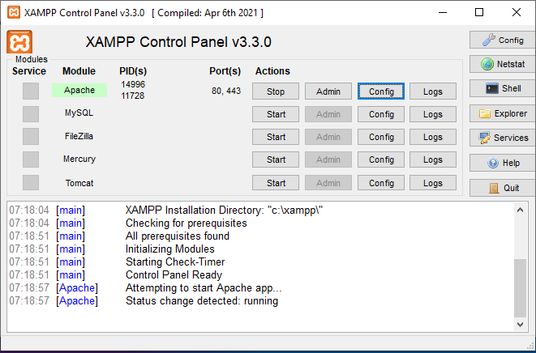
Introduction to PHP

Slide 4
Introduction to PHP
PHP (Hypertext Preprocessor) is a widely-used open-source scripting language primarily designed for web development. It was created by Danish-Canadian programmer Rasmus Lerdorf in 1993 and has since evolved into one of the most popular languages for building dynamic web applications.
Key Features of PHP:
Server-Side Scripting Language:
PHP runs on the server, which means that it is used to process data and generate dynamic content before sending it to the client’s browser.
Embedded in HTML:
PHP code can be embedded within HTML files, making it easy to integrate with existing web pages. This allows developers to create dynamic web pages that interact with databases, manage sessions, handle forms, and more.
Cross-Platform:
PHP is platform-independent, meaning it can run on various operating systems like Windows, Linux, and macOS. It also works well with popular web servers like Apache and Nginx.
Open Source:
PHP is free to use, and it has an extensive community of developers who contribute to its development and offer support.

Slide 5
Introduction to PHP
Database Integration:
PHP is often used with databases such as MySQL, PostgreSQL, and SQLite, allowing developers to create dynamic, data-driven websites like blogs, e-commerce platforms, and content management systems.
Rich Set of Libraries and Frameworks:
PHP offers a wide range of libraries and frameworks (such as Laravel, Symfony, and CodeIgniter) that help developers streamline development by providing ready-to-use components for common tasks.
Security:
While PHP provides tools to secure applications (such as input validation, encryption, and secure session management), it’s essential for developers to be mindful of best practices to avoid vulnerabilities like SQL injection or XSS (Cross-Site Scripting).
PHP Tags:
PHP code is written between
<?php and ?> tags.

Slide 6
Introduction to PHP
Variables:
PHP variables begin with a $ sign and do not need to be declared before use.
$name = "John";
echo $name; // Outputs: John
Comments:
PHP supports single-line
(// or #) and multi-line (/* */) comments.
// This is a single-line comment
/* This is a
multi-line comment */

Slide 7
Introduction to PHP
Functions:
Functions in PHP are declared using the function keyword
function greet($name) {
return "Hello, " . $name;
}
echo greet("Alice"); // Outputs: Hello, Alice
Conditional Statements:
PHP supports common control structures like if, else, and switch.
$age = 20;
if ($age >= 18) {
echo "You are an adult.";
} else {
echo "You are a minor.";
}

Slide 8
Introduction to PHP
Loops:
PHP has for, while, and foreach loops for iteration.
for ($i = 1; $i <= 5; $i++) {
echo $i . " ";
}
// Outputs: 1 2 3 4 5

Slide 9
Introduction to PHP
This simple PHP form takes input from the user and displays a personalized greeting.
Common Use Cases for PHP:
Form Processing:
PHP is commonly used to process and validate forms, such as login pages or contact forms.
Database Interaction:
PHP works seamlessly with databases, making it ideal for building dynamic, data-driven websites like blogs, e-commerce sites, or forums.
Content Management Systems (CMS):
PHP powers popular CMS platforms like WordPress, Joomla, and Drupal, allowing users to manage their websites without coding knowledge.
E-commerce:
PHP is used in building e-commerce platforms such as Magento, WooCommerce, and Shopify.
REST APIs:
PHP can be used to build RESTful APIs for web services that communicate with mobile apps, other websites, or client-side applications.

Slide 10
Thank You

